Slide 1


Coffee Chain Performance Analysis
Presented by Kritika Kumari

Slide 2
Introduction
Objective of the analysis: To analyze sales, profit, and overall performance across regions and product lines, and identify key growth opportunities.
Focus Areas:
Yearly sales and profit trends
Product line and product type performance
Market and regional trends
Expense and profitability insights
Used Power BI to clean the dataset using Power Query Editor and then visualized the data in the dashboard.

Slide 3
Executive Summary
Key Metrics:
Total Sales: 203K
Profit: 64K
Expenses: 57K
Average Profit Margin: 15.94%
Sales and profit grew until 2014, then dipped in 2015.
Central & East regions show strong performance.
Espresso and Coffee lead in sales and profit.

Slide 4
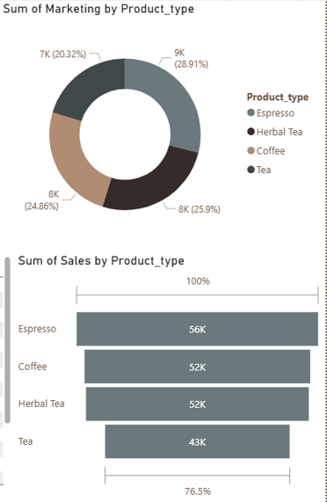
Product Line & Product Type Insights
Beans line outperformed Leaves, exceeding targets in multiple years.
Consistent sales growth across the period.
Espresso and Coffee dominate both sales and profitability.
Tea products need innovation or marketing refresh to stay competitive.

Slide 5
Sales & Profit Insights
Sales and profit both showed a strong upward trend between 2012–2014.
2014 is the peak year and the performance across most regions and product lines is high.
In 2015, sales declined slightly, and profit margins contracted as expenses rose.
Sales outperformed targets in Beans and Coffee segments, showing strong demand.
Profit margin volatility suggests an opportunity to refine pricing and cost structures.

Slide 6
Profitability & Cost Analysis
Profit and expenses both rose steadily till 2014.
In 2015, Expenses plateaued at a high level, reducing net profitability.
Indicates need for operational efficiency and cost discipline.
Expense-to-sales ratio widened post 2013, trimming even 5 - 8% could boost margins significantly.

Slide 7
Regional & Market Insights
Major Markets generated 103K in total sales.
Smaller Markets accounted for 99K, showing potential for growth with targeted promotions.
Top-performing states include:
California (23K sales, 7.3K profit)
Illinois (16.8K sales, 7.3K profit)
New York (17.7K sales, 5.6K profit)
Underperforming states like Missouri, New Mexico, and New Hampshire show low sales, suggesting limited market exposition or weaker brand presence.

